Slide 1
Cloud Tools Overview

Slide 2
Hadoop

Slide 3
Outline
Hadoop - Basics
HDFS
  Goals
  Architecture
  Other functions
MapReduce
  Basics
  Word Count Example
  Handy tools
  Finding shortest path example
Related Apache sub-projects (Pig, HBase,Hive)

Slide 4
Hadoop - Why ?
Need to process huge datasets on large clusters of computers
Very expensive to build reliability into each application
Nodes fail every day
  Failure is expected, rather than exceptional
  The number of nodes in a cluster is not constant
Need a common infrastructure
  Efficient, reliable, easy to use
  Open Source, Apache Licence

Slide 5
Who uses Hadoop?
Amazon/A9
Facebook
Google
New York Times
Veoh
Yahoo!
…. many more

Slide 6
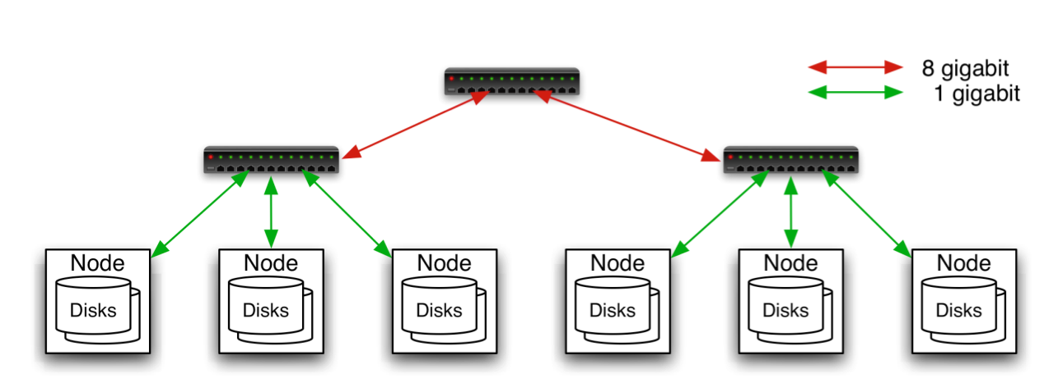
Commodity Hardware
Aggregation switch
Rack switch
Typically in 2 level architecture
  Nodes are commodity PCs
  30-40 nodes/rack
  Uplink from rack is 3-4 gigabit
  Rack-internal is 1 gigabit

Slide 7
Hadoop Distributed File System (HDFS)
Original Slides by
Dhruba Borthakur
Apache Hadoop Project Management Committee

Slide 8

Goals of HDFS
Very Large Distributed File System
  10K nodes, 100 million files, 10PB
Assumes Commodity Hardware
  Files are replicated to handle hardware failure
  Detect failures and recover from them
Optimized for Batch Processing
  Data locations exposed so that computations can move to where data resides
  Provides very high aggregate bandwidth

Slide 9
Distributed File System
Single Namespace for entire cluster
Data Coherency
  Write-once-read-many access model
  Client can only append to existing files
Files are broken up into blocks
  Typically 64MB block size
  Each block replicated on multiple DataNodes
Intelligent Client
  Client can find location of blocks
  Client accesses data directly from DataNode

Slide 10
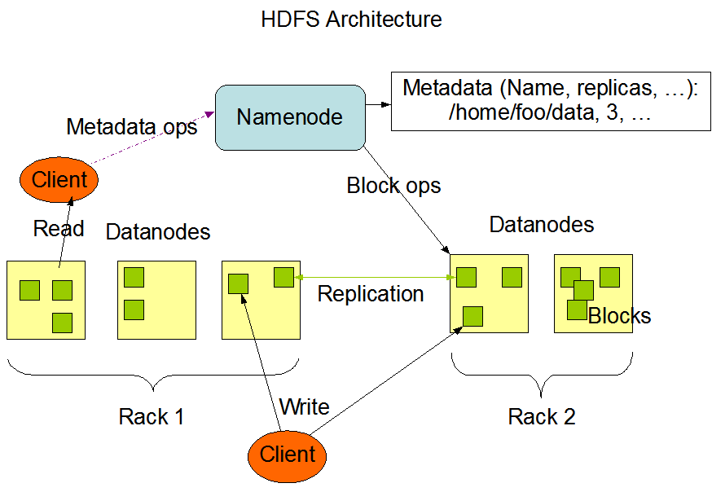
HDFS Architecture

Slide 11
Functions of a NameNode
Manages File System Namespace
  Maps a file name to a set of blocks
  Maps a block to the DataNodes where it resides
Cluster Configuration Management
Replication Engine for Blocks

Slide 12
NameNode Metadata
Metadata in Memory
  The entire metadata is in main memory
  No demand paging of metadata
Types of metadata
  List of files
  List of Blocks for each file
  List of DataNodes for each block
  File attributes, e.g. creation time, replication factor
A Transaction Log
  Records file creations, file deletions etc

Slide 13
DataNode
A Block Server
  Stores data in the local file system (e.g. ext3)
  Stores metadata of a block (e.g. CRC)
  Serves data and metadata to Clients
Block Report
  Periodically sends a report of all existing blocks to the NameNode
Facilitates Pipelining of Data
  Forwards data to other specified DataNodes

Slide 14
Block Placement
Current Strategy
  One replica on local node
  Second replica on a remote rack
  Third replica on same remote rack
  Additional replicas are randomly placed
Clients read from nearest replicas
Would like to make this policy pluggable

Slide 15
Heartbeats
DataNodes send hearbeat to the NameNode
  Once every 3 seconds
NameNode uses heartbeats to detect DataNode failure

Slide 16
Replication Engine
NameNode detects DataNode failures
  Chooses new DataNodes for new replicas
  Balances disk usage
  Balances communication traffic to DataNodes

Slide 17
Data Correctness
Use Checksums to validate data
  Use CRC32
File Creation
  Client computes checksum per 512 bytes
  DataNode stores the checksum
File access
  Client retrieves the data and checksum from DataNode
  If Validation fails, Client tries other replicas

Slide 18
NameNode Failure
A single point of failure
Transaction Log stored in multiple directories
  A directory on the local file system
  A directory on a remote file system (NFS/CIFS)
Need to develop a real HA solution

Slide 19
Data Pieplining
Client retrieves a list of DataNodes on which to place replicas of a block
Client writes block to the first DataNode
The first DataNode forwards the data to the next node in the Pipeline
When all replicas are written, the Client moves on to write the next block in file

Slide 20
Rebalancer
Goal: % disk full on DataNodes should be similar
  Usually run when new DataNodes are added
  Cluster is online when Rebalancer is active
  Rebalancer is throttled to avoid network congestion
  Command line tool

Slide 21
Secondary NameNode
Copies FsImage and Transaction Log from Namenode to a temporary directory
Merges FSImage and Transaction Log into a new FSImage in temporary directory
Uploads new FSImage to the NameNode
  Transaction Log on NameNode is purged

Slide 22
User Interface
Commads for HDFS User:
  hadoop dfs -mkdir /foodir
  hadoop dfs -cat /foodir/myfile.txt
  hadoop dfs -rm /foodir/myfile.txt
Commands for HDFS Administrator
  hadoop dfsadmin -report
  hadoop dfsadmin -decommision datanodename
Web Interface
  http://host:port/dfshealth.jsp

Slide 23
MapReduce
Original Slides by
Owen O’Malley (Yahoo!)
&
Christophe Bisciglia, Aaron Kimball & Sierra Michells-Slettvet

Slide 24
MapReduce - What?
MapReduce is a programming model for efficient distributed computing
It works like a Unix pipeline
  cat input | grep | sort | uniq -c | cat > output
  Input | Map | Shuffle & Sort | Reduce | Output
Efficiency from
  Streaming through data, reducing seeks
  Pipelining
A good fit for a lot of applications
  Log processing
  Web index building

Slide 25
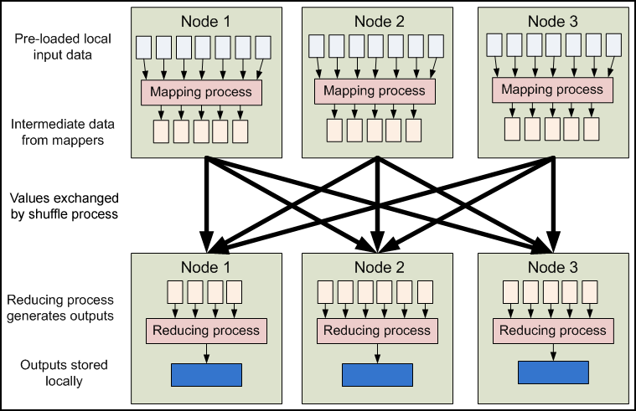
MapReduce - Dataflow

Slide 26
MapReduce - Features
Fine grained Map and Reduce tasks
  Improved load balancing
  Faster recovery from failed tasks
Automatic re-execution on failure
  In a large cluster, some nodes are always slow or flaky
  Framework re-executes failed tasks
Locality optimizations
  With large data, bandwidth to data is a problem
  Map-Reduce + HDFS is a very effective solution
  Map-Reduce queries HDFS for locations of input data
  Map tasks are scheduled close to the inputs when possible

Slide 27
Word Count Example
Mapper
  Input: value: lines of text of input
  Output: key: word, value: 1
Reducer
  Input: key: word, value: set of counts
  Output: key: word, value: sum
Launching program
  Defines this job
  Submits job to cluster

Slide 28
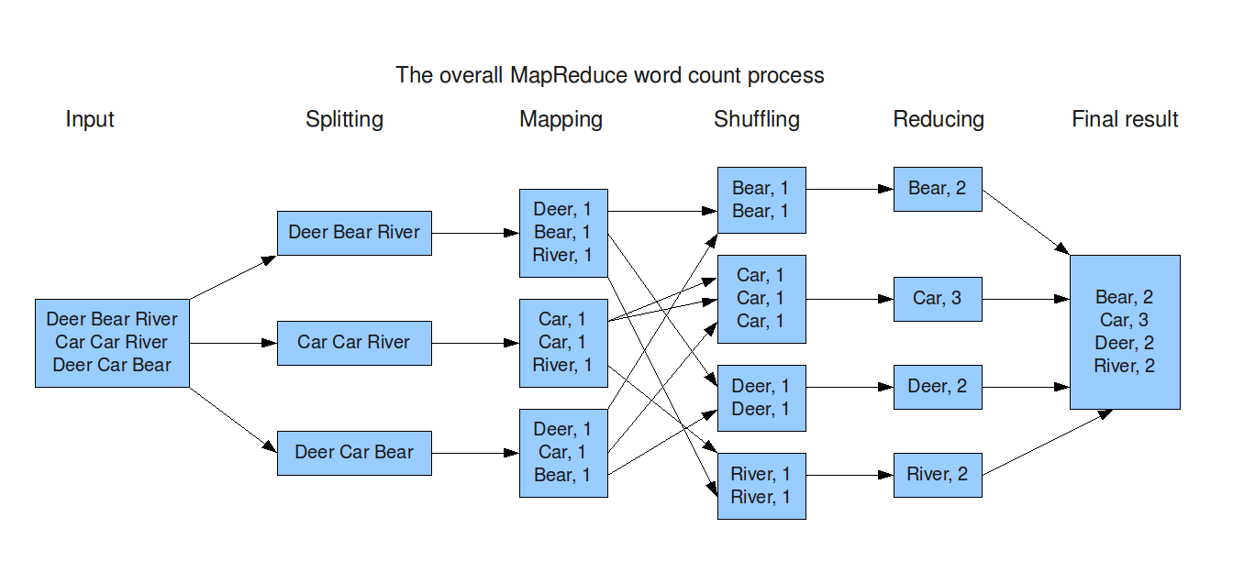
Word Count Dataflow

Slide 29
Word Count Mapper
public static class Map extends MapReduceBase implements Mapper<LongWritable,Text,Text,IntWritable> {
private static final IntWritable one = new IntWritable(1);
private Text word = new Text();
public static void map(LongWritable key, Text value, OutputCollector<Text,IntWritable> output, Reporter reporter) throws IOException {
String line = value.toString();
StringTokenizer = new StringTokenizer(line);
while(tokenizer.hasNext()) {
word.set(tokenizer.nextToken());
output.collect(word,one);
}
}
}

Slide 30
Word Count Reducer
public static class Reduce extends MapReduceBase implements Reducer<Text,IntWritable,Text,IntWritable> {
public static void map(Text key, Iterator<IntWritable> values, OutputCollector<Text,IntWritable> output, Reporter reporter) throws IOException {
int sum = 0;
while(values.hasNext()) {
sum += values.next().get();
}
output.collect(key, new IntWritable(sum));
}
}

Slide 31
Word Count Example
Jobs are controlled by configuring JobConfs
JobConfs are maps from attribute names to string values
The framework defines attributes to control how the job is executed
  conf.set(“mapred.job.name”, “MyApp”);
Applications can add arbitrary values to the JobConf
  conf.set(“my.string”, “foo”);
  conf.set(“my.integer”, 12);
JobConf is available to all tasks

Slide 32
Putting it all together
Create a launching program for your application
The launching program configures:
  The Mapper and Reducer to use
  The output key and value types (input types are inferred from the InputFormat)
  The locations for your input and output
The launching program then submits the job and typically waits for it to complete

Slide 33
Putting it all together
JobConf conf = new JobConf(WordCount.class);
conf.setJobName(“wordcount”);
conf.setOutputKeyClass(Text.class);
conf.setOutputValueClass(IntWritable.class);
conf.setMapperClass(Map.class);
conf.setCombinerClass(Reduce.class);
conf.setReducer(Reduce.class);
conf.setInputFormat(TextInputFormat.class);
Conf.setOutputFormat(TextOutputFormat.class);
FileInputFormat.setInputPaths(conf, new Path(args[0]));
FileOutputFormat.setOutputPath(conf, new Path(args[1]));
JobClient.runJob(conf);

Slide 34
Input and Output Formats
A Map/Reduce may specify how it’s input is to be read by specifying an InputFormat to be used
A Map/Reduce may specify how it’s output is to be written by specifying an OutputFormat to be used
These default to TextInputFormat and TextOutputFormat, which process line-based text data
Another common choice is SequenceFileInputFormat and SequenceFileOutputFormat for binary data
These are file-based, but they are not required to be

Slide 35
How many Maps and Reduces
Maps
  Usually as many as the number of HDFS blocks being processed, this is the default
  Else the number of maps can be specified as a hint
  The number of maps can also be controlled by specifying the minimum split size
  The actual sizes of the map inputs are computed by:
    max(min(block_size,data/#maps), min_split_size
Reduces
  Unless the amount of data being processed is small
    0.95*num_nodes*mapred.tasktracker.tasks.maximum

Slide 36
Some handy tools
Partitioners
Combiners
Compression
Counters
Speculation
Zero Reduces
Distributed File Cache
Tool

Slide 37
Partitioners
Partitioners are application code that define how keys are assigned to reduces
Default partitioning spreads keys evenly, but randomly
  Uses key.hashCode() % num_reduces
Custom partitioning is often required, for example, to produce a total order in the output
  Should implement Partitioner interface
  Set by calling conf.setPartitionerClass(MyPart.class)
  To get a total order, sample the map output keys and pick values to divide the keys into roughly equal buckets and use that in your partitioner

Slide 38
Combiners
When maps produce many repeated keys
  It is often useful to do a local aggregation following the map
  Done by specifying a Combiner
  Goal is to decrease size of the transient data
  Combiners have the same interface as Reduces, and often are the same class
  Combiners must not side effects, because they run an intermdiate number of times
  In WordCount, conf.setCombinerClass(Reduce.class);

Slide 39
Compression
Compressing the outputs and intermediate data will often yield huge performance gains
  Can be specified via a configuration file or set programmatically
  Set mapred.output.compress to true to compress job output
  Set mapred.compress.map.output to true to compress map outputs
Compression Types (mapred(.map)?.output.compression.type)
  “block” - Group of keys and values are compressed together
  “record” - Each value is compressed individually
  Block compression is almost always best
Compression Codecs (mapred(.map)?.output.compression.codec)
  Default (zlib) - slower, but more compression
  LZO - faster, but less compression

Slide 40
Counters
Often Map/Reduce applications have countable events
For example, framework counts records in to and out of Mapper and Reducer
To define user counters:
  static enum Counter {EVENT1, EVENT2};
  reporter.incrCounter(Counter.EVENT1, 1);
Define nice names in a MyClass_Counter.properties file
  CounterGroupName=MyCounters
  EVENT1.name=Event 1
  EVENT2.name=Event 2

Slide 41
Speculative execution
The framework can run multiple instances of slow tasks
  Output from instance that finishes first is used
  Controlled by the configuration variable mapred.speculative.execution
  Can dramatically bring in long tails on jobs

Slide 42
Zero Reduces
Frequently, we only need to run a filter on the input data
  No sorting or shuffling required by the job
  Set the number of reduces to 0
  Output from maps will go directly to OutputFormat and disk

Slide 43
Distributed File Cache
Sometimes need read-only copies of data on the local computer
  Downloading 1GB of data for each Mapper is expensive
Define list of files you need to download in JobConf
Files are downloaded once per computer
Add to launching program:
  DistributedCache.addCacheFile(new URI(“hdfs://nn:8020/foo”), conf);
Add to task:
  Path[] files = DistributedCache.getLocalCacheFiles(conf);

Slide 44
Tool
Handle “standard” Hadoop command line options
  -conf file - load a configuration file named file
  -D prop=value - define a single configuration property prop
Class looks like:
  public class MyApp extends Configured implements Tool {
  public static void main(String[] args) throws Exception {
  System.exit(ToolRunner.run(new Configuration(), new MyApp(), args));
  }
  public int run(String[] args) throws Exception {
  …. getConf() ….
  }
  }

Slide 45
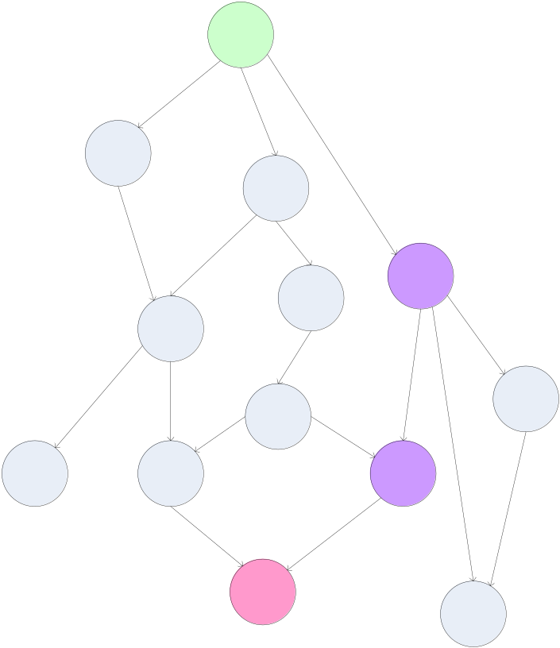
Finding the Shortest Path
A common graph search application is finding the shortest path from a start node to one or more target nodes
Commonly done on a single machine with Dijkstra’s Algorithm
Can we use BFS to find the shortest path via MapReduce?

Slide 46
Finding the Shortest Path: Intuition
We can define the solution to this problem inductively
  DistanceTo(startNode) = 0
  For all nodes n directly reachable from startNode, DistanceTo(n) = 1
  For all nodes n reachable from some other set of nodes S,
    DistanceTo(n) = 1 + min(DistanceTo(m), m ∈ S)

Slide 47
From Intuition to Algorithm
A map task receives a node n as a key, and (D, points-to) as its value
  D is the distance to the node from the start
  points-to is a list of nodes reachable from n
∀p ∈ points-to, emit (p, D+1)
Reduces task gathers possible distances to a given p and selects the minimum one

Slide 48
What This Gives Us
This MapReduce task can advance the known frontier by one hop
To perform the whole BFS, a non-MapReduce component then feeds the output of this step back into the MapReduce task for another iteration
  Problem: Where’d the points-to list go?
  Solution: Mapper emits (n, points-to) as well

Slide 49
Blow-up and Termination
This algorithm starts from one node
Subsequent iterations include many more nodes of the graph as the frontier advances
Does this ever terminate?
  Yes! Eventually, routes between nodes will stop being discovered and no better distances will be found. When distance is the same, we stop
  Mapper should emit (n,D) to ensure that “current distance” is carried into the reducer

Slide 50
Hadoop Subprojects

Slide 51
Hadoop Related Subprojects
Pig
  High-level language for data analysis
HBase
  Table storage for semi-structured data
Zookeeper
  Coordinating distributed applications
Hive
  SQL-like Query language and Metastore
Mahout
  Machine learning

Slide 52
Pig
Original Slides by
Matei Zaharia
UC Berkeley RAD Lab

Slide 53

Pig
Started at Yahoo! Research
Now runs about 30% of Yahoo!’s jobs
Features
  Expresses sequences of MapReduce jobs
  Data model: nested “bags” of items
  Provides relational (SQL) operators
  (JOIN, GROUP BY, etc.)
  Easy to plug in Java functions

Slide 54
An Example Problem
Suppose you have user data in a file, website data in another, and you need to find the top 5 most visited pages by users aged 18-25
Load Users
Load Pages
Filter by age
Join on name
Group on url
Count clicks
Order by clicks
Take top 5

Slide 55
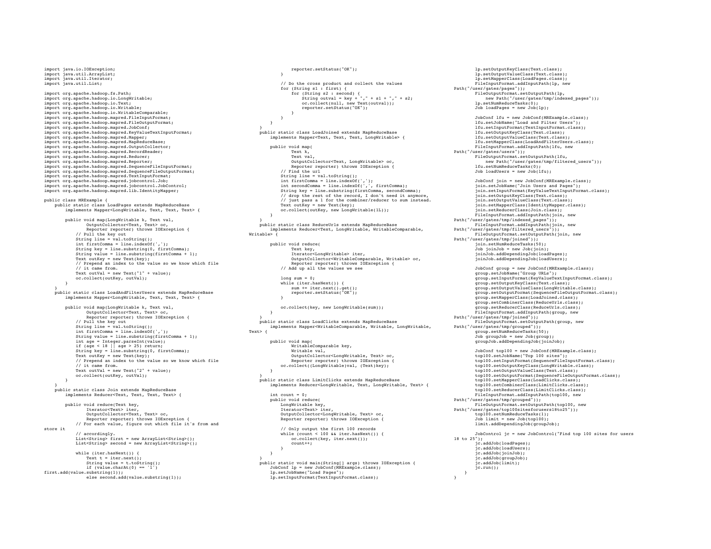
In MapReduce

Slide 56
In Pig Latin
Users = load ‘users’ as (name, age);
Filtered = filter Users by age >= 18 and age <= 25;
Pages = load ‘pages’ as (user, url);
Joined = join Filtered by name, Pages by user;
Grouped = group Joined by url;
Summed = foreach Grouped generate group,
count(Joined) as clicks;
Sorted = order Summed by clicks desc;
Top5 = limit Sorted 5;
store Top5 into ‘top5sites’;

Slide 57
Ease of Translation
Load Users
Load Pages
Users = load …
Fltrd = filter …
Pages = load …
Joined = join …
Grouped = group …
Summed = … count()…
Sorted = order …
Top5 = limit …
Filter by age
Join on name
Group on url
Count clicks
Order by clicks
Take top 5

Slide 58
Ease of Translation
Load Users
Load Pages
Users = load …
Fltrd = filter …
Pages = load …
Joined = join …
Grouped = group …
Summed = … count()…
Sorted = order …
Top5 = limit …
Filter by age
Join on name
Job 1
Group on url
Job 2
Count clicks
Order by clicks
Job 3
Take top 5

Slide 59
HBase
Original Slides by
Tom White
Lexeme Ltd.

Slide 60
HBase - What?
Modeled on Google’s Bigtable
Row/column store
Billions of rows/millions on columns
Column-oriented - nulls are free
Untyped - stores byte[]

Slide 61
HBase - Data Model
Row | Timestamp | Column family: animal: |  | Column family repairs:
 |  | animal:type | animal:size | repairs:cost
enclosure1 | t2 | zebra |  | 1000 EUR
 | t1 | lion | big
enclosure2 | … | … | … | …

Slide 62
HBase - Data Storage
Column family animal:
(enclosure1, t2, animal:type) | zebra
(enclosure1, t1, animal:size) | big
(enclosure1, t1, animal:type) | lion
Column family repairs:
(enclosure1, t1, repairs:cost) | 1000 EUR

Slide 63
HBase - Code
HTable table = …
Text row = new Text(“enclosure1”);
Text col1 = new Text(“animal:type”);
Text col2 = new Text(“animal:size”);
BatchUpdate update = new BatchUpdate(row);
update.put(col1, “lion”.getBytes(“UTF-8”));
update.put(col2, “big”.getBytes(“UTF-8));
table.commit(update);
update = new BatchUpdate(row);
update.put(col1, “zebra”.getBytes(“UTF-8”));
table.commit(update);

Slide 64
HBase - Querying
Retrieve a cell
Cell = table.getRow(“enclosure1”).getColumn(“animal:type”).getValue();
Retrieve a row
RowResult = table.getRow( “enclosure1” );
Scan through a range of rows
Scanner s = table.getScanner( new String[] { “animal:type” } );

Slide 65
Hive
Original Slides by
Matei Zaharia
UC Berkeley RAD Lab

Slide 66

Hive
Developed at Facebook
Used for majority of Facebook jobs
“Relational database” built on Hadoop
  Maintains list of table schemas
  SQL-like query language (HiveQL)
  Can call Hadoop Streaming scripts from HiveQL
  Supports table partitioning, clustering, complex data types, some optimizations

Slide 67
Creating a Hive Table
CREATE TABLE page_views(viewTime INT, userid BIGINT,
page_url STRING, referrer_url STRING,
ip STRING COMMENT 'User IP address')
COMMENT 'This is the page view table'
PARTITIONED BY(dt STRING, country STRING)
STORED AS SEQUENCEFILE;
Partitioning breaks table into separate files for each (dt, country) pair
Ex: /hive/page_view/dt=2008-06-08,country=USA
/hive/page_view/dt=2008-06-08,country=CA

Slide 68
A Simple Query
Find all page views coming from xyz.com on March 31st:
SELECT page_views.*
FROM page_views
WHERE page_views.date >= '2008-03-01'
AND page_views.date <= '2008-03-31'
AND page_views.referrer_url like '%xyz.com';
Hive only reads partition 2008-03-01,* instead of scanning entire table

Slide 69
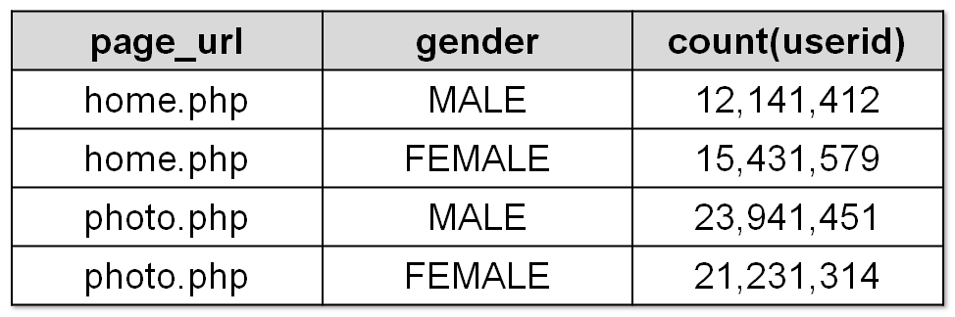
Aggregation and Joins
Count users who visited each page by gender:
Sample output:
SELECT pv.page_url, u.gender, COUNT(DISTINCT u.id)
FROM page_views pv JOIN user u ON (pv.userid = u.id)
GROUP BY pv.page_url, u.gender
WHERE pv.date = '2008-03-03';

Slide 70
Using a Hadoop Streaming Mapper Script
SELECT TRANSFORM(page_views.userid, page_views.date)
USING 'map_script.py'
AS dt, uid CLUSTER BY dt
FROM page_views;

Slide 71
Storm
Original Slides by
Nathan Marz
Twitter

Slide 72

Storm
Developed by BackType which was acquired by Twitter
Lots of tools for data (i.e. batch) processing
  Hadoop, Pig, HBase, Hive, …
None of them are realtime systems which is becoming a real requirement for businesses
Storm provides realtime computation
  Scalable
  Guarantees no data loss
  Extremely robust and fault-tolerant
  Programming language agnostic

Slide 73
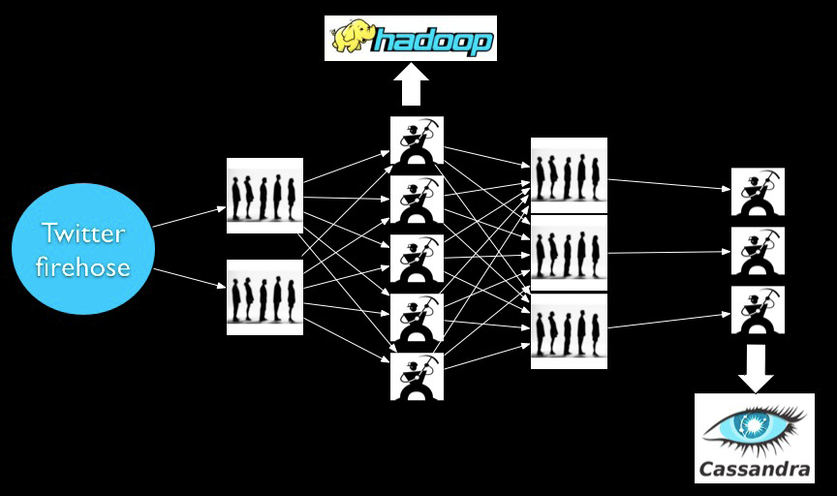
Before Storm

Slide 74
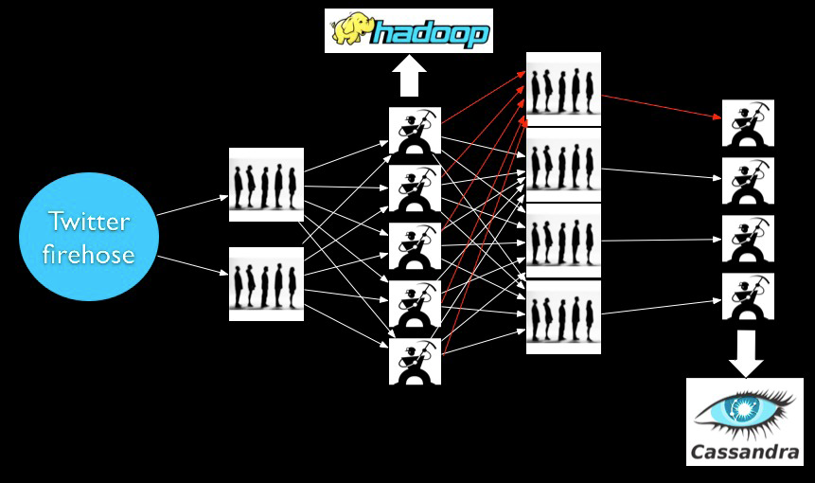
Before Storm – Adding a worker
Deploy
Reconfigure/Redeploy

Slide 75
Problems
Scaling is painful
Poor fault-tolerance
Coding is tedious

Slide 76
What we want
Guaranteed data processing
Horizontal scalability
Fault-tolerance
No intermediate message brokers!
Higher level abstraction than message passing
“Just works” !!

Slide 77
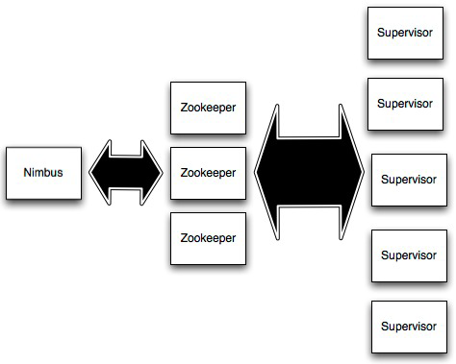
Storm Cluster
Master node (similar to
Hadoop JobTracker)
Used for cluster coordination
Run worker processes

Slide 78
Concepts
Streams
Spouts
Bolts
Topologies

Slide 79
Streams
Tuple
Tuple
Tuple
Tuple
Tuple
Tuple
Tuple
Unbounded sequence of tuples

Slide 80



Spouts
Source of streams

Slide 81



Bolts
Processes input streams and produces new streams:
Can implement functions such as filters, aggregation, join, etc

Slide 82
Topology
Network of spouts and bolts

Slide 83
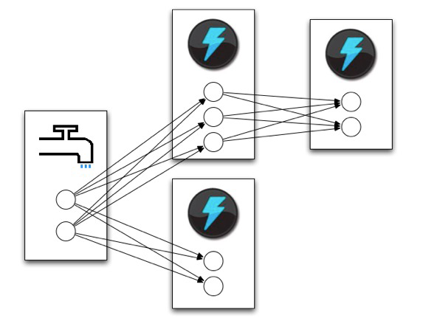
Topology
Spouts and bolts execute as
many tasks across the cluster

Slide 84
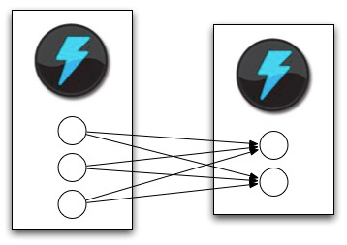
Stream Grouping
When a tuple is emitted which task does it go to?

Slide 85
Stream Grouping
Shuffle grouping: pick a random task
Fields grouping: consistent hashing on a subset of tuple fields
All grouping: send to all tasks
Global grouping: pick task with lowest id

